Slide 1

https://www.uni-goettingen.de/en/48115.html
UNPLAB-QuGen_Ch-11[QG Lines I]
Quantitative Genetics for Line Breeding
1

Slide 2
Sequential Number: #45
UNPLAB-QuGen_Ch-11[QG Lines I]
Unless I explicitly state otherwise, images and cartoons are created using ChatGPT.
You may use this material free of charge under the terms of the CC BY license. This requires that you provide appropriate attribution to the author:
W. Link, University of Goettingen, Germany.
In a few cases, individual images, photographs, or similar material may be subject to a more restrictive Creative Commons license. Where this applies, it is explicitly indicated, and you must comply with the stated license terms for those items.
Please check the license information carefully before reuse. Responsibility for complying with the applicable license terms rests entirely with you.
2

Slide 3
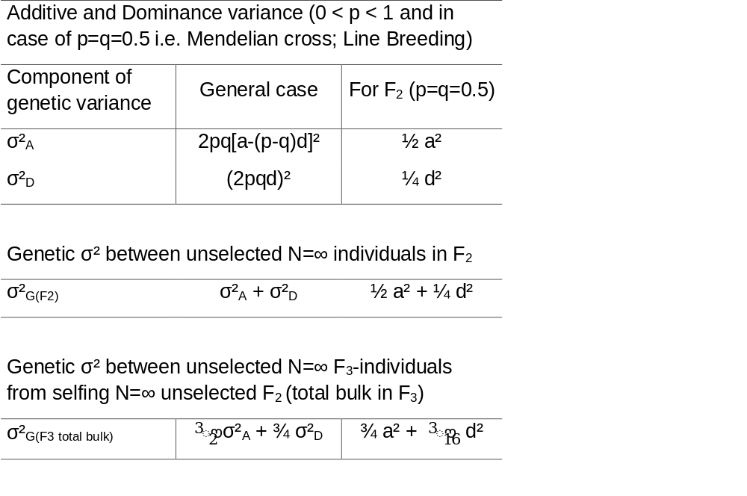
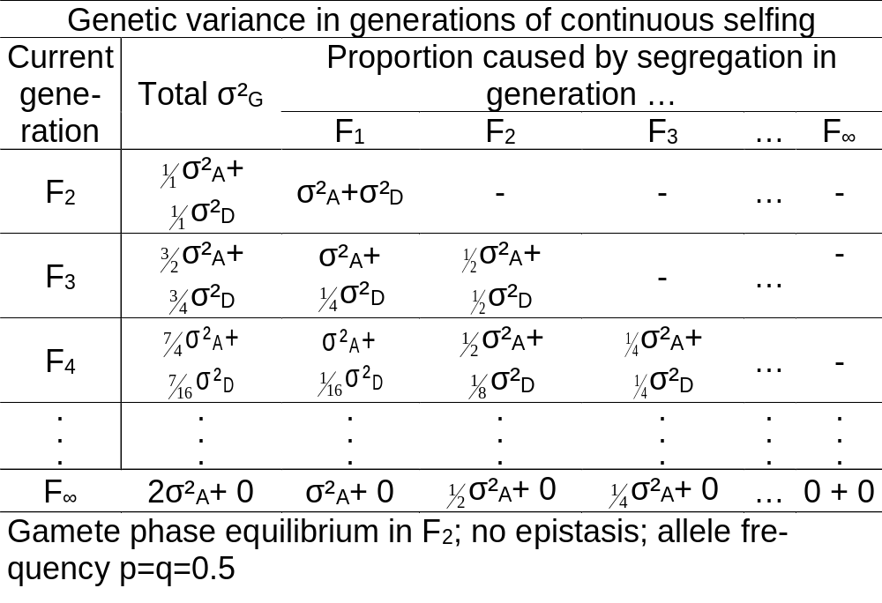
You already know: Population Genetics (HWE, Inbreeding, Drift, Selection, Equilibrium of Selection and Mutation, Equilibrium of Selection and Drift, Gamete Phase Disequilibrium; the decomposition of the Phenotypic Variance, GxE inlcuding Stability and Breeder‘s Equation; Breeding Methods incl. Heterosis, GCA, Recurrent Selection Schemes, and the Four Categories of Plant Breeding with their Methods; Correlated Traits and Index Selection; the parameters of the Metric Model and of the Statistical Model, the decomposition of the Genetic Variance.
Keywords of this chapter: Genetic segregation in the inbred progenies of a Mendelian Cross, such as F2,
F3 and beyond.
Left: Interme-diate goal
Right: Final
goal
3

Slide 4
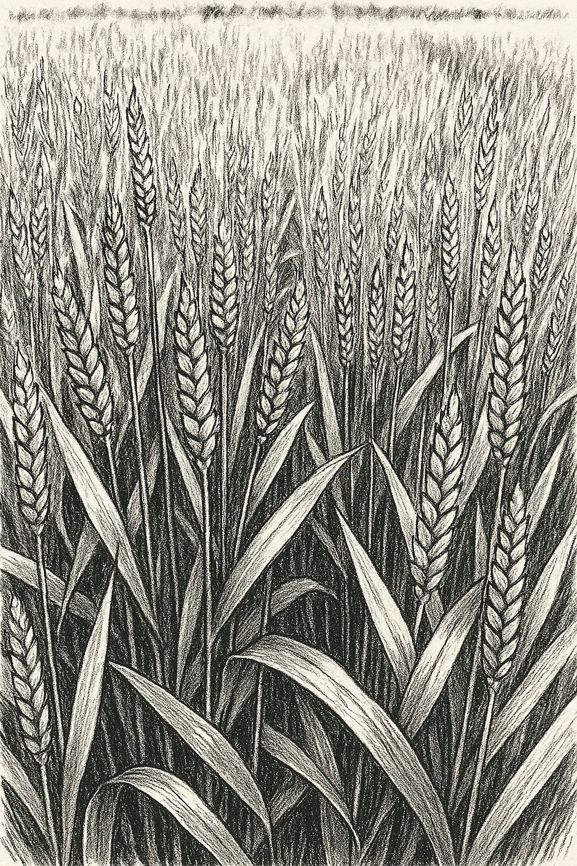
Conducting crosses (such as manually and artifi-cially crossing different types of wheat or of barley, or rice etc.) was only accepted and employed as tool to release novel diversity for genetic selection after pioneers such as the Australian William James Farrer (1845-1906) demonstrated it. This was seve-ral years before Mendel’s laws of inheritance were rediscovered and discussed for application.
One of the very early wheat cultivars bred by Line Breeding with a cross as start was the English type ‘Yeoman wheat’, bred at the Plant Breeding Institute Cambridge by Sir R. Biffen.
In 1916, he crossed a 'Canadian Red Fife’ type with Browick, at that time a low protein British wheat type.
DOI 10.1007/978-94-009-3131-2_3
https://www.sciencesocieties.org/files/publications/slide-sets-example.pdf
https://www.ebsco.com/research-starters/law/rediscovery-mendels-hereditary-theory.
This is how AI ‚fatamorganized‘ the Yeoman wheat in 2025
4

Slide 5
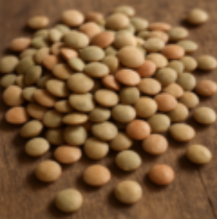
If the Reference Population is made homozygous, then we may model its genetic vari-ance as σ²_{G} =2 σ²_{A} + 4 D₁ + D₂* (UNPLAB-QuGen_Ch-10[GenV 0_F_1]). But here (Line Breeding) we focus on just one cross (with homozygous unrelated parents) and the variance from it. Our cross is an ‘normal’, ‘average’, ‘to-be expected’ cross.
Base population 2 (pool of parents)
Focus is on just one cross
P2
Random gamete or homozygous genotype; family of random homozygous lines
F1-hybrid genotype
F1-hybrid and unselec-ted, random homozygous lines (DH; RIL) from it
x
F1
P1
All lines from all crosses - hence the Entirety of the Reference Population
Base population 1 (pool of parents)
Bulk of DHs
Lentil seed, a crop with line cultivars.
5

Slide 6
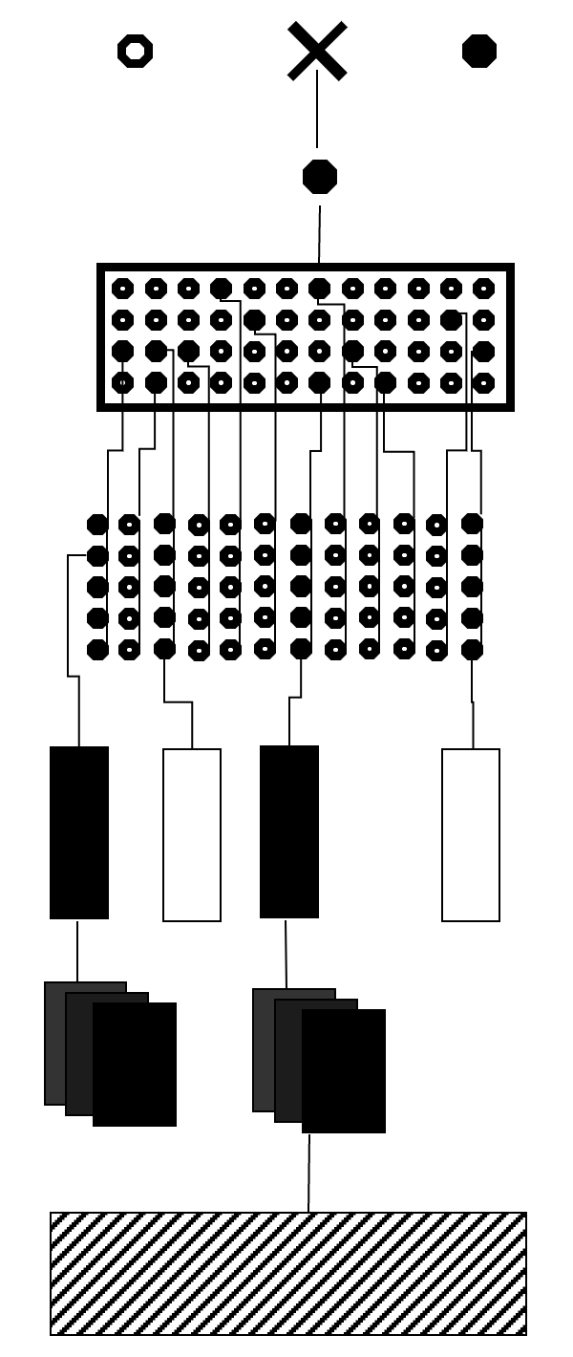
If the Reference Population is made homozygous, then we may model its genetic vari-ance as σ²_{G} =2 σ²_{A} + 4 D₁ + D₂* (UNPLAB-QuGen_Ch-10[GenV 0_F_1]). But here (Line Breeding) we focus on just one cross (with homozygous unrelated parents) and the variance from it. Our cross is an ‘normal’, ‘average’, ‘to-be expected’ cross.
6
Focus is on just one cross
All crosses i.e. the Entirety of the Reference Population ►
σ²_{G} =2 σ²_{A} + 4 D₁ + D₂* describes the total genetic variance at F=1 (between all individuals of the Reference Population).
A first half of this σ²_{G} is between the many homozygous bulks (F=1) bred from the many initial individuals (F=0) in HWE.
The second half of this is within: Segregating within any cross; between the DHs or RILs (F=1) that make one homozygous Bulk, bred from one random member (F=0) of the HWE popula-tion (no SelMutMigrDrift). !!¡¡ Each individual of the HWE population is the equivalent on one Mendelian Cross in F1.
We know the possible allele frequency p(A1) within our cross! Either p=0.0 or p=1.0 (F1 happened to be homozygous); or p=q=0.5 (F1 happened to be heterozygous). In this case
σ²_{G(within)} = σ²_{A} + 2 D₁ + ½ D₂* = 2pqa² = ½ a² (again: F=1).
We are going to see how this ‘homozygous’ additive variance evolves and is displayed to be exploited in Line Breeding.
P2
x
F1
P1
DH lines
Ultrashort sketch of Pedigree Selection, a classical Line Breeding Method
;-) with p=q, D1 & D2*
are both zero
6

Slide 7
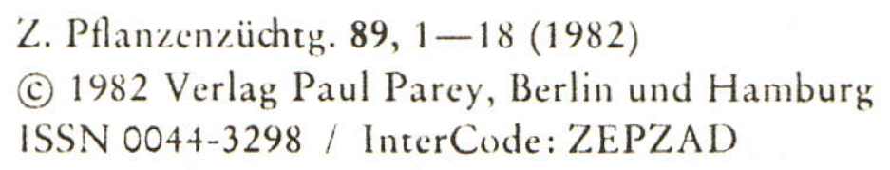
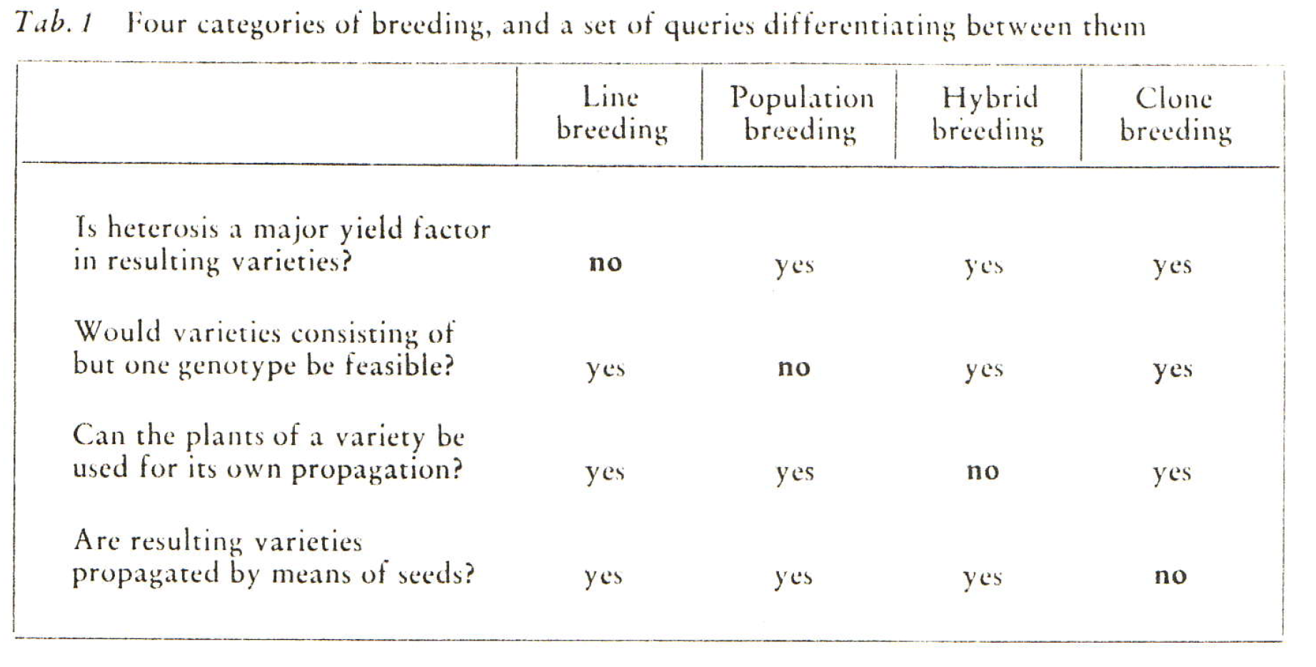
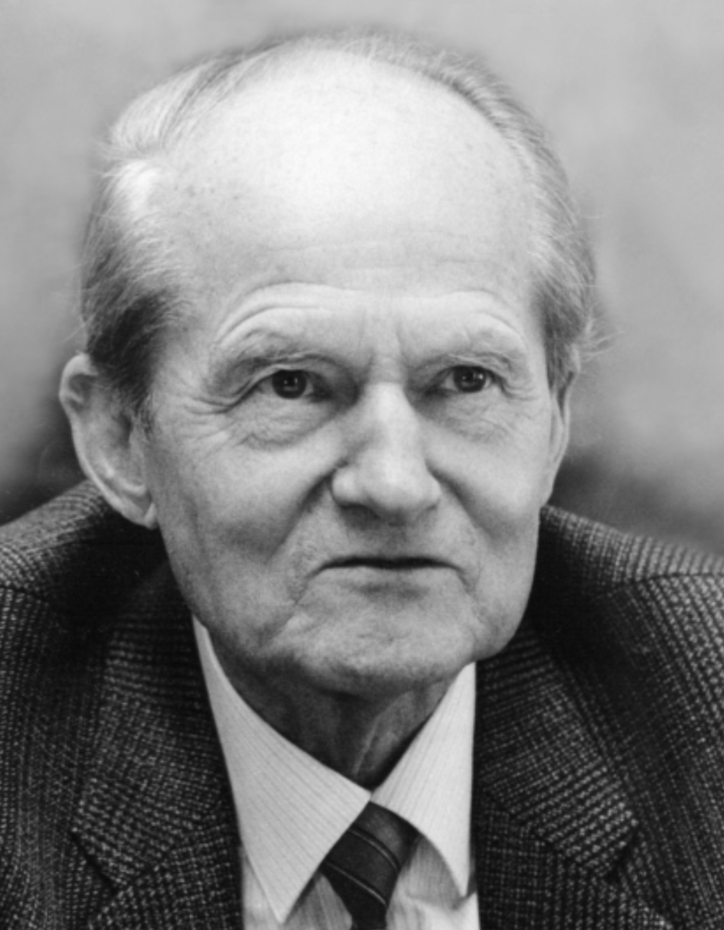
One of few core items to teach and to understand Plant Breeding Metho-dology. © FWS. Hohenheim.
F. Wolfgang Schnell
(1984: ‘FWS’) CCBY-SA 3.0 © Sabine Schnell, Familie FWS, Germany.
7

Slide 8
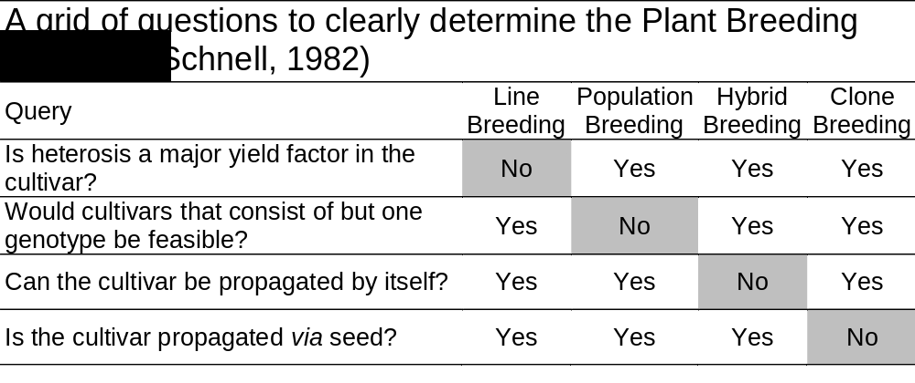
One of few core items to teach and to understand Plant Breeding Metho-dology. © FWS Hohenheim.
8

Slide 9
Heterosis is a major factor in three out of four Plant Breeding Categories; et cetera.
Before looking at Quantitative Genetics models that fit to Line Breeding, let us remember the four Categories and their main features.
Line cvs. do not exploit heterosis, where-as Population, Hybrid, Clone cvs. do.
A Population cv. must embody an effect-tive N_{e} >>1 to well-allow heterosis; it then consists of N≈∞ unique, different genotypes.
Yes Yes Yes
9
A Hybrid cv. can indeed* be propagated from the seed that is its grain yield. Yet, the next generation is not any more the same genotype (due to segregation) and will suffer from some inbreeding depression (*if male sterility plays a rôle, this adds some complexity).
Clone cvs. are not propagated by seed but by vegetative propagules such as cuttings (fruit trees, grape), tubers (potato), onions and the like. Farmers do not sow potatoes but plant them, just as they plant cherry trees. Yet, they sow their corn or oats (and do not plant it). Although clover can very easily be vegetatively propagated (with a trowel or a pocket knife, without any laboratory equipment), clover breeding is not Clone Breeding ... because farmer do not plant their clover field but seed it from the certified seed they buy from their trusted seed dealer.
9

Slide 10
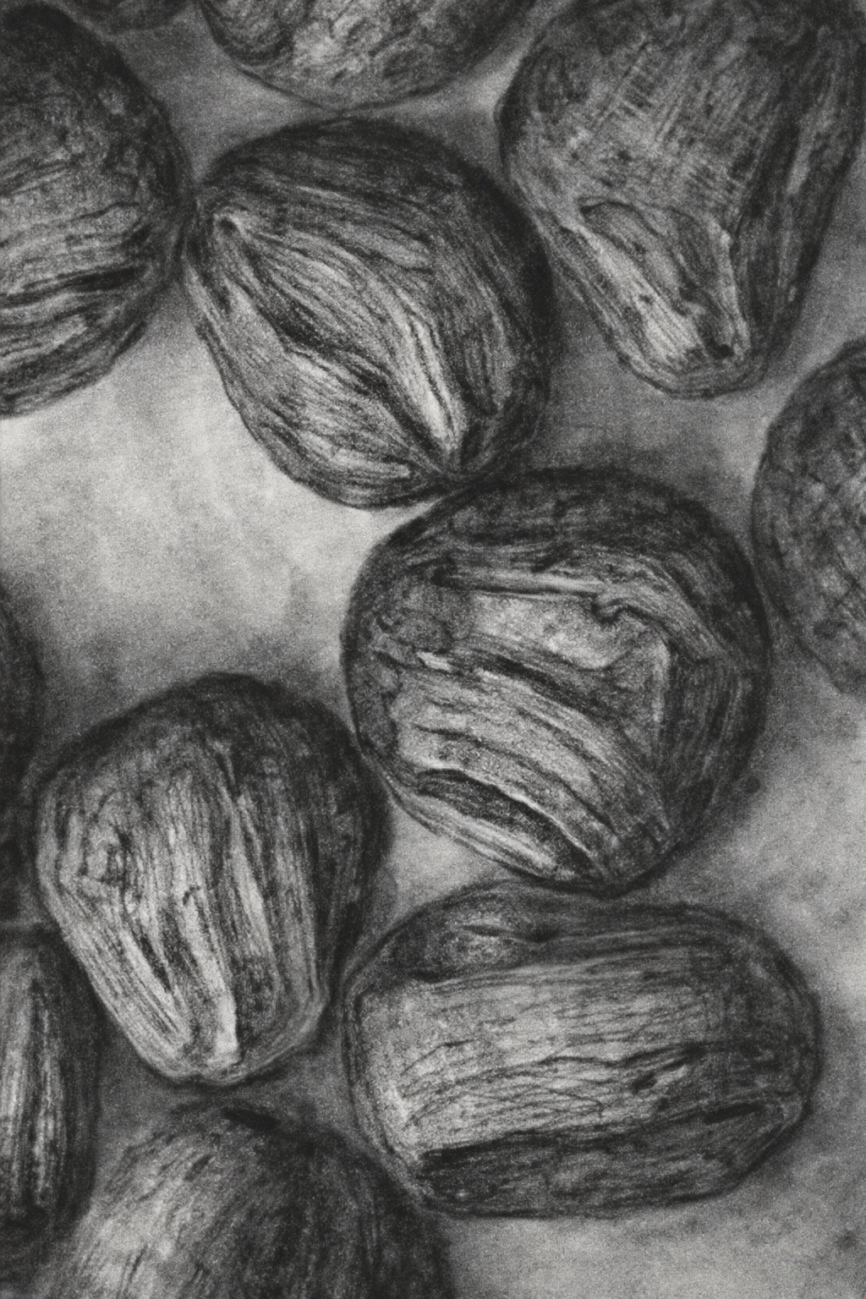
One of few core items to teach and to understand Plant Breeding Methodology.
Line Breeder exerts the maximum intensi-ty of selection: the cv. „is“ (normally) only one („the best“) genotype, established from the best available/identifiable „personalized gamete“. A homozygous plant from selfing an already homozygous plant has 'twice' the genes of the maternal gamete that made it, just as it has 'twice' the genes of its paternal gamete (both are same). As sporophyte, as plant; grasp it
as ‘person’ .. just this gamete 'twice'.
The pollen grains shall help to ‘visualize’ gametes; and since often we produce DH- lines from pollen grains, so please grasp the idea of the personalized gamete.
Already when breeding an F1 hybrids (or clone) cv., you have to add to your ‘best’ inbred parent (or gamete) a second (!second) best; a compromise that is unknown in Line Bree-ding (the best alone makes the cv.). This disadvantage is normally (over-)compensated by heterosis in the hybrids or clones. In Population cvs., the intensity of selection is even lower, since several or many different genotypes (gametes) are used to establish such cv. If you have very many candidates, the difference in value between best and 2nd best (etc.) is smaller than if there are only few of them. Hence, then, with many, the penalty of adding 2nd best ... is smaller; yet any advantage of doing so may stay ;-)
Corn pollen grains
10

Slide 11
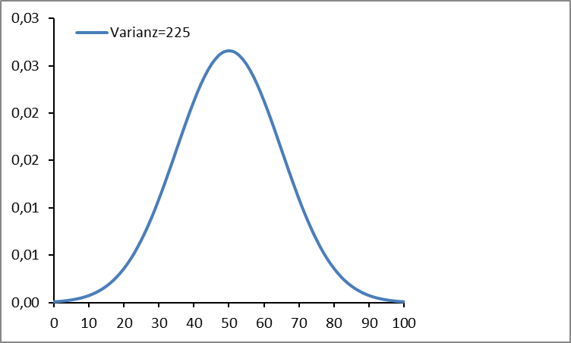
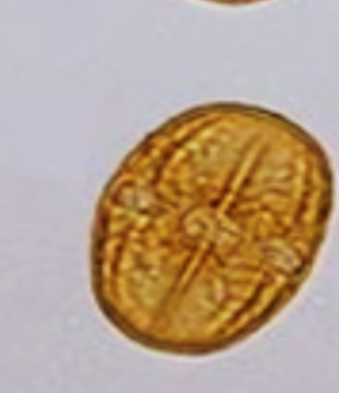
Visualization of this ‚Selection Intensity‘ difference between Plant Breeding Categories:
Best-ever ‚doubled gamete-type‘ vs. best-plus-2nd-best vs. best-plus-several more.
In Line Breeding, breeders exert maximum intensity of selection: The cultivar „is“ (normally) only one („the best“) genotype, established from the best available/identifiable inbred lines (aka 'personalized gametes').
Example: Best one of N=12 normally distributed candidates that are availabe for selection. The best is then - expectedly - 1.629 SD above mean. This is at 74.4 on our scale. In Line Breeding, that one would make the cultivar.
In Hybrid breeding: Select the best + add the 2nd (expected at 1.134 SD above mean, hence at 70.6). The hybrid cv. then should perform (74.4+70.6)/2 + heterosis; probably then higher than 74.4. For a population cv., assume e.g. N=6 lines as components to initiate it: Select best, 2nd-best .. until six^{th}-best (mean outcome is 61.223).
Vicia faba Pollen Grain © Marzinzig
SD=15
Again: The mean of these six lines is then
50 + (1.629+1.116+0.793+0.537+0.312+0.103)/6)∙15 = 61.223; plus some* heterosis. Whether this then is really higher than 74.4 remains to be seen; depends on share* and size of heterosis that can be ‘put’ into the cv.
For the ‘Order Statistics’: Becker, W.A., 1984- Manual of Quantitative Genetics. 4th Edition, University of Michigan. ISBN 0931399009. Page 331.
74.4
70.6
61.2
*UNPLAB-BrMeth_Ch-4[GCA II] page 14,15.
11

Slide 12
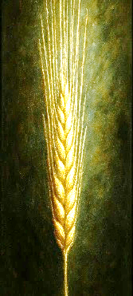
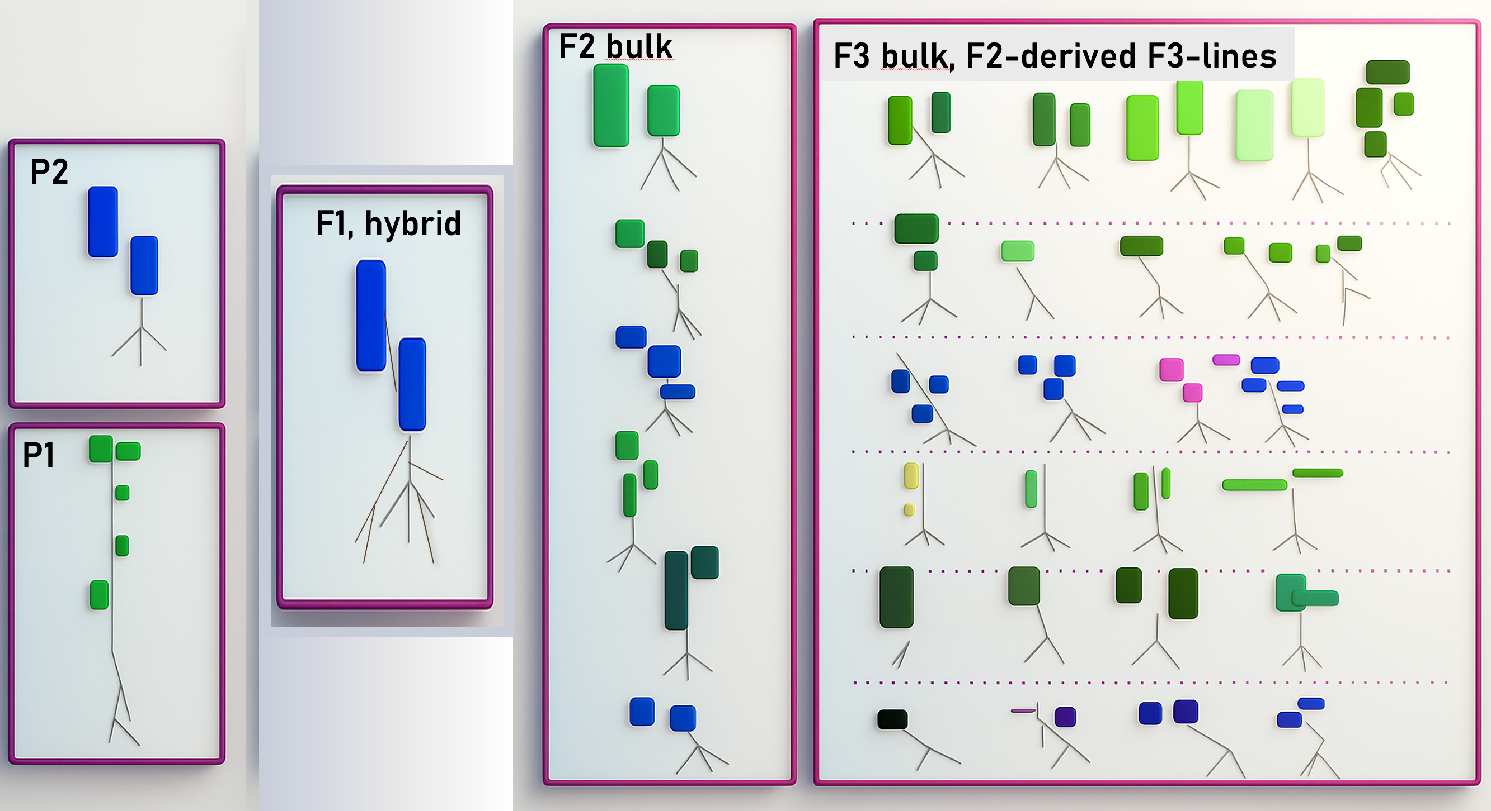
Sketch of the first generations of a Line Breeding program (© W. Link).
Upon crossing two homozygous, geneti-cally different parents (not necessarily with only one plant per pa-rent), you come to a Mendelian F1-gene-ration (it is irrelevant whether you have N=1 F1-plant or several ones, you know why).
Upon selfing the F1 (or crossing among several individuals of this F1, what a waste of effort) ... you get the genera-tion F2.
. . . . . . . . . .
. . . . . . . . . .
. . . . . . . . . .
. . . . . . . . . .
. . . . . . . . . .
F2 is then the first segregating generation. It ‚displays‘ the segregation of the male and female gametes of (from) the F1. No meaningful grouping of F2 plants is possible, all are pedigree-related to each other to the same extent.
12

Slide 13
All propagation here is self-fertilization, and there is no selection yet (not breeding yet).
self-fertilization
You easily see that features such as leaf colour, leaf size, leaf number per plant, plant length, root length ... differ between parents. You see (F1 vs. P1, P2): Blue is dominant over greenish, tallish over short.
In F2, you see that even colours other than parental blue and green can occur, obviously because colour is not monogenetic. Et cetera.
Quantitative Genetics wants to algebraically model the amount of genetic variance that is displayed in F2; and wants to model the amount of genetic variance that is displayed as contrasts between the F3-lines. ...
Of course, a blue short F2-plant produces blue short offspring as F3-line; although there is still some segregation between these F3-indiviudals for colour and further features. The genetic differences between P1 and P2 cause the heterozygosity in F1. The heterozygous loci in F1 segregate, produce segregating gametes and thus cause the segregation ‘displayed’ in F2. This variation between the F2-individuals should be twice the variance between the F3-individuals in any of the F3-lines! Because: Within F3-lines, only what was heterozygous in its F2 individual allowed segregation within our F3-line (variation between its individuals). You know: F2-individuals are, on average, only heterozygous at ½ as many loci a their F1 ancestor => you see the point.
Let us see whether things are that straight ;-) dominance; epistasis; epigenetics ... polygenic, gamete phase ...
13

Slide 14
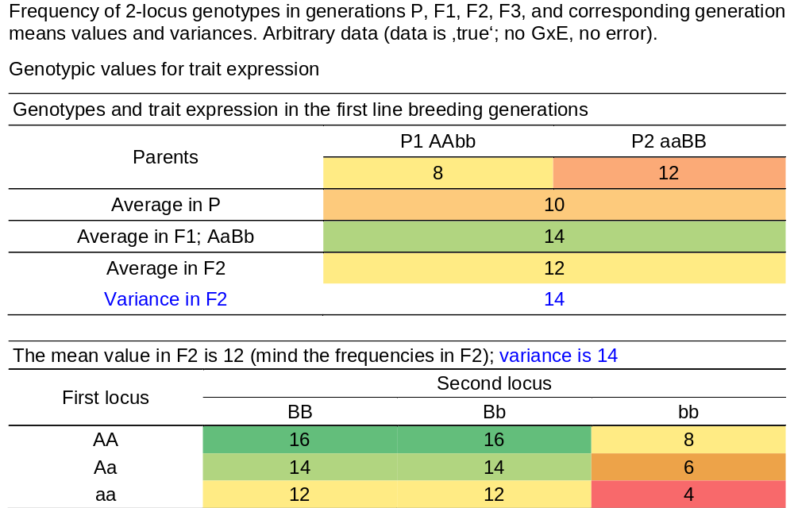
An arbitrary 2-loci example of parents, F1, and segregation in F2. Genotypic data.
Quantitative Genetics looks often on just one trait, the genetic variance of which is controlled by several loci.
So, here, different geno-types may have the same ‚true‘ genetic value. In our example this is because of dominance. In exam-ples with many loci, it would even be because it is irrelevant which actual loci contribute the increa-sing and decreasing effects, as long as the sum comes to the same aggregate value (trait expression value).
14

Slide 15
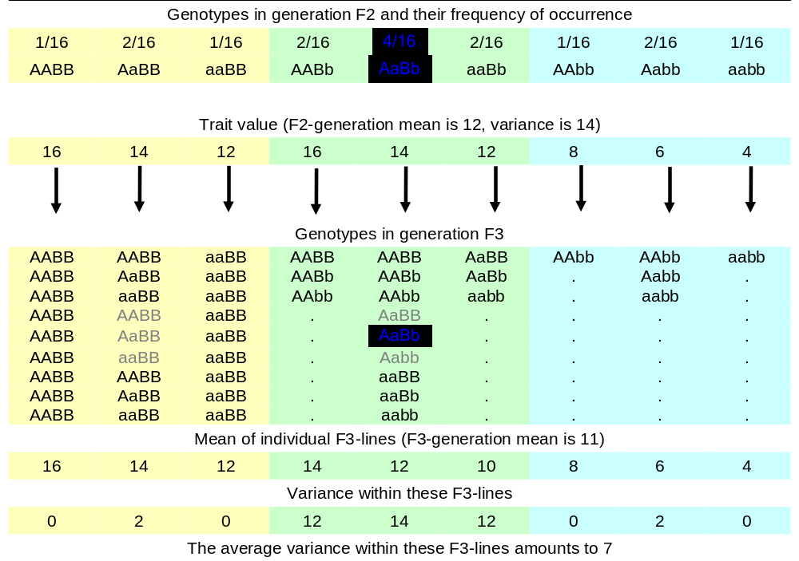
Segregation beyond F2!!
Genotypes have their frequencies. For instance, in the F3-line which was established by selfing an F2-individual AaBb, we find the indi-vidual F3 genotype AaBb, and it makes 25% of that F3-line. We find there the individual genotype AABB, and that one makes only 1/16 = 6.25% of the plants of that F3-line. This type of F3-line is by itself quite frequent (25%), because it stems from an F2-individual which was - in F2 - quite frequent (25% = 4/16 as you see). And so on. This is important if you want to re-calculate 'my' mean values here and 'my' variance results. Have fune, re-calculate them! Obey to the frequencies of occurrence!
15

Slide 16
Some columns in F3 are listed ‚in full‘, further ones only display each there-occurring genotype once (zero linkage, i.e. c=0.5 aka λ =1; LD=0; UNPLAB-PopGen_Ch-10[LD II])
The F2-individual AABB (frequency of occurrence 1/16) does not segregate. All its F3-offspring is identical to it and to each other; the genetic variance within this F3-line is zero; at these two loci, well noted!
The F2-individual aaBb segregates at the second locus only. Yet, this is the stronger locus (a=4; d=4) compared to the first locus, and it has domi-nance. Therefore, the segregation is quite strong, variance within this F3-line is σ²=12. The mean of this line is lower than the genetic value of the F2-genotype which established it (10<12), because the metric d-effect is less frequent in this F3 line (F3 plants are less often heterozygous than F2 plants - you know).
16

Slide 17
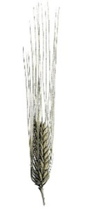
A di-hybrid segregation like this here is not really ‚Quantitative Genetics‘.
Quantitative Genetics is useful to model cases with many, very many segregating loci.
We are less discussing individual cases (this line vs. that line). We illu-strate two loci yet aim at very many loci. Even if a specific F2-individual does not segregate for these two loci, it will segregate at others. We aim at the typically-to-be-expected case looking on many loci simultaneously.
We take the mean of all the different within (in-side) F3-line variances to quantify our variance within F3-lines. We take the means of σ²=0, σ²=2, σ²=0, σ²=12 ... (mind their frequencies) and find the mean variance within F3-lines of σ²=7. Exactly half of σ²=14 in F2.
The variance between the F3-lines amounts to 11 (11>7; did you expect it like this?).
The average variance within these F3-lines amounts to 7
The variance between these F3-lines amounts to 11
17

Slide 18
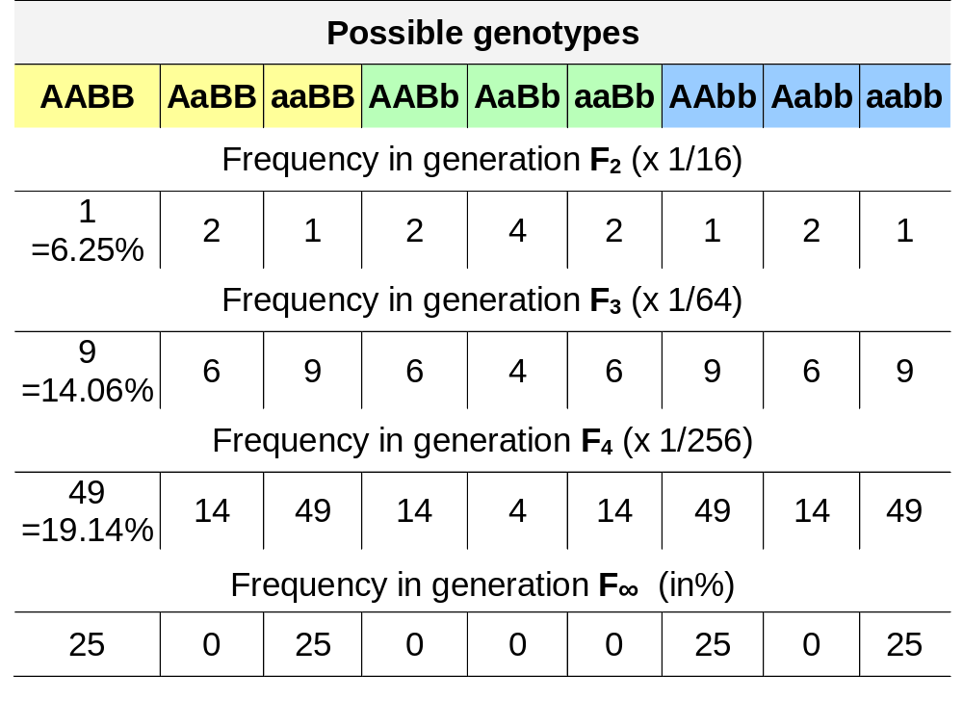
Reminder: Although all eventually occurring genotypes already occur in F2, the frequency of multiple-homozygotes is higher in F∞ (aka RILs) than earlier.
18
This is a case with no linkage, i.e. c=0.5 aka λ =1. Hence: LD=0.
If you go through generations F₁, F₂, F₃, etc. without Selection and Drift (no Mutation, Mi-gration anyway), and no linkage, then you have these results. With some linkage, the result depends on the gamete phase (AB or rather aB etc.). With F₆ or higher, you would call the set of resulting lines ‚RIL‘, i.e. Recombinant Inbred Lines.
A set of DH lines is very similar to a set of RILs, just that there is more LD decay among RILs than among DH (strong linkage means low LD decay but double of the small decay in RILs compared to DH).
See UNPLAB-PopGen_Ch-11 page 26.

Slide 19
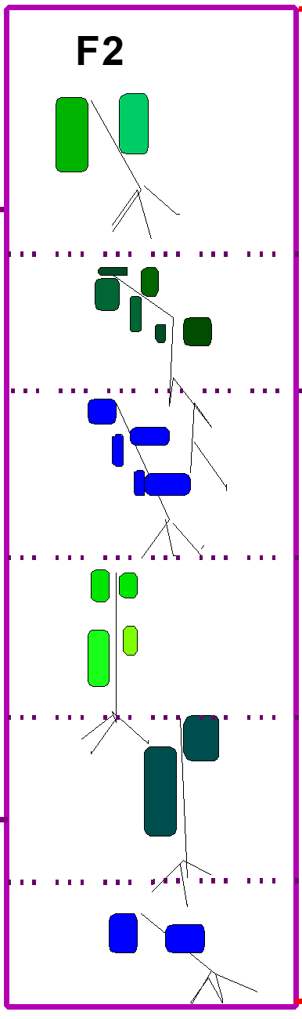
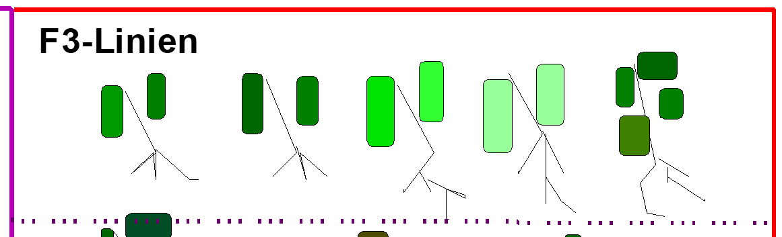

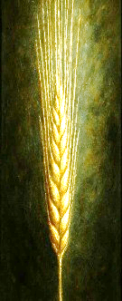
Genetic variance in the (unselected) generations of Line Breeding increases from zero in F1 in a very systematic way towards is ultimate value in F∞; a clear, simple manner.
Repeated and ongoing self-fertilization decreases the proportion of loci and genotypes that are ‘still’ heterozygous and segregate at a given locus ... decrease is by half per selfing generation.
A single F2-derived F3-line
Consequently, the proportion of genotypes being fixed for the one or other allele increases per each selfing generation.
The genetic heterogeneity within single-plants’ offspring is decreasing and homogeneity increases per each selfing in the progeny of that initial single-plant.
single-plants
single-plants
The increase of homogeneity within the (not-yet-fully homogeneous) lines is connected with an increase of genetic differences between these lines. These changes in the structure and pattern of genetic variability – along the generations of self-fertilization - are accompanied by an increase of the displayed Additive Variance and a decrease of the Dominance Variance.
Take allele frequencies of p = q = 0.5 (true in the unselected offspring of our bi-parental cross from homozygous parents): In spite of inbreeding, we see no covariances between the effects of the genetic model (additive, dominance, epistasis). Therefore, the variances from segregation between and within lines (and groups of lines and families of sub-lines as arising due to continuous selfing without selection) can be written as simple functions of our ;-) genetic variance components. We will visit them and tabulate the results - to have a pretty and clear lay-out .
19

Slide 20
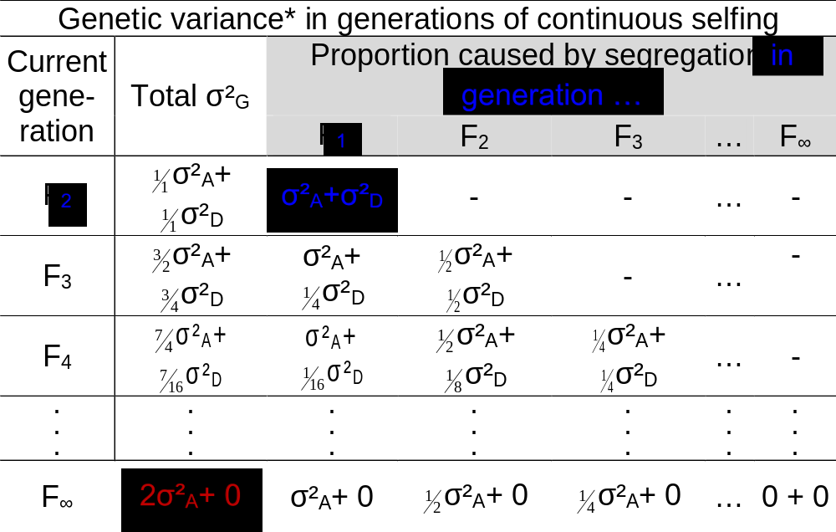
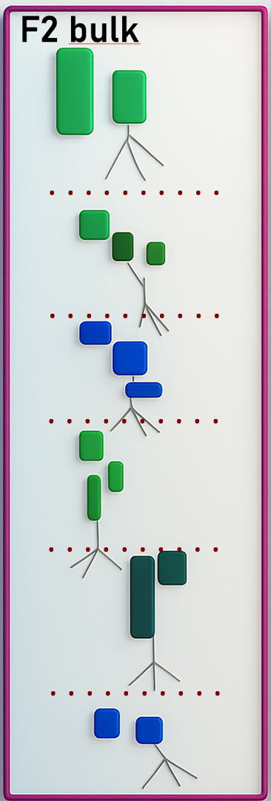
The genetic variance in the (unselected) generations of Line Breeding changes from F1 towards F∞ in a very systematic, clear and relatively simple manner.
From F2 to F∞:
The total variance σ²_{G}
in the total bulk of RILs as derived from the cross (from F1; no selection) gains (doubles) in additive variance and looses all dominance variance.
Total σ²_{G}
σ²_{A}= ½ a²
σ²_{D}= ¼ d²
σ²_{G}= σ²_{A} + σ²_{D} σ²_{G}= ½ a² + ¼ d²
σ²_{A} + σ²_{D}
But.
Let us step back and look at the single items more closely and slower ;-)
… and come back to this here slightly bit later.
*Assumptions: p=q=0.5, LD=0, no Epistasis
20

Slide 21
You may, if you are in a hurry and if you don't have the leisure or time to enjoy different perspectives on the same thing, then you can from here directly jump to page 33.
21

Slide 22
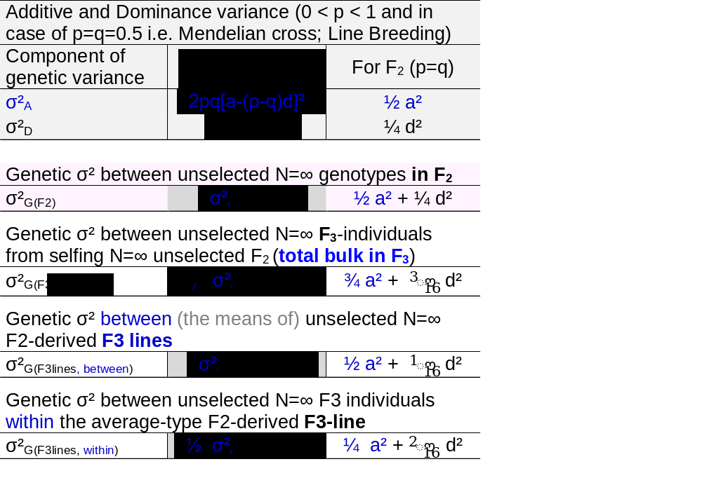
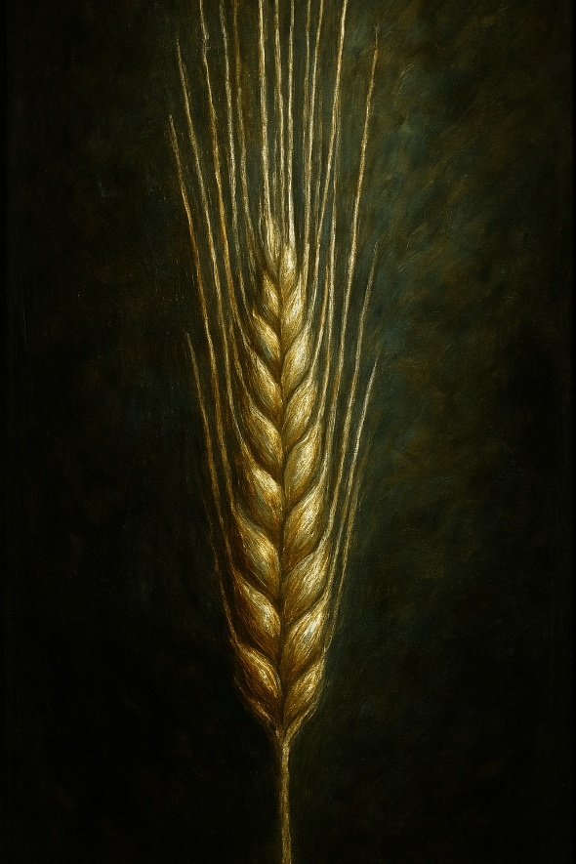
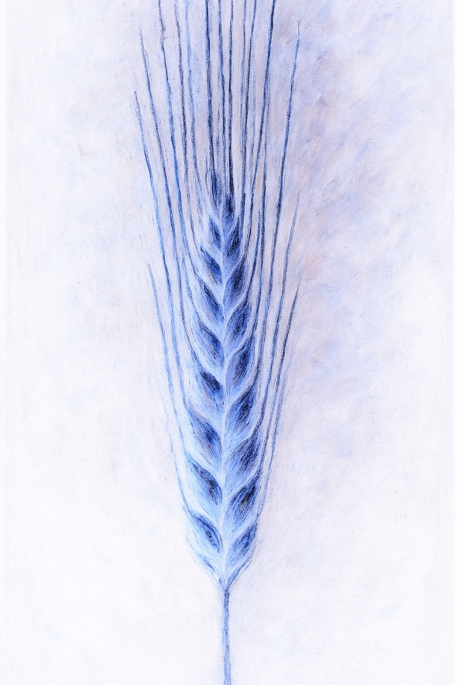
Not only is F2 accidentally in a HWE equilibrium setting; moreover, the individuals …
... cannot meaningfully be grouped. They are, based on their pedigree, all related to each other to the same extend. But* in ‘reality’, there is true genetic segregation for (1) their mono-genic, oligogenic etc. genotype, (2) their level of homozygosity, (3) their shares of grandparents’ P1 and P2 genomes (consequently thus for their realized genetic simila-
* see UNPLAB-BrMeth_Ch-10
[TheFour III]
Reminder: One cross
rity: “~All are equal, but some are more equal than others”. Orwell, ‘45).
Take for a moment that ‘this F2 is all-what-is for this species in the Universe’, then ‘this F2’ is the Reference Population, its inbree-ding is then F=0 and we accept its HWE status happily (well, still a slightly strange perspective).
And: The hypothesis of maximum 2 alleles is naïve and artificial, just to simplify things). Neglect epistasis, epigenetics, magic .... anyway.
P2
x
F1
P1
F2 Bulk
RIL Bulk
Cereal ears to symbolize self-fertili-zation (not all cereals are ‚selfers‘).
22
22

Slide 23
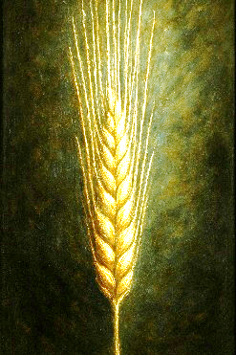
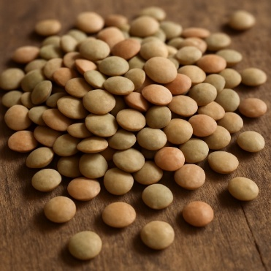
Not only is F2 accidentally in a HWE equilibrium setting; moreover, the individuals …
... cannot meaningfully be grouped. They are, based on their pedigree, all related to each other to the same extend. But in ‘reality’, there is true genetic segregation for (1) their mono-genic, oligogenic etc. genotype, (2) their level of homozygosity, (3) their shares of grandparents’ P1 and P2 genomes (consequently thus for their realized genetic simila-
rity: “~All are equal, but some are more equal than others”. Orwell, ‘45).
Take for a moment that ‘this F2 is all-what-is for this species in the Universe’, then ‘this F2’ is the Reference Population, its inbree-ding is then F=0 and we accept its HWE status happily (well, still a slightly strange perspective).
And: The hypothesis of maximum 2 alleles is naïve and artificial, just to simplify things). Neglect epistasis, epigenetics, magic .... anyway.
Two self-fertilizing species.
23

Slide 24
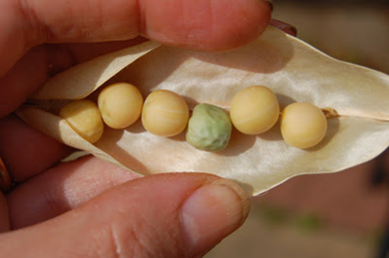
Twice genetic σ² between F2-individuals than within their F3-lines.
Why is this? In F2, half are homozygous (for loci which were different between P1 and P2 in the first place); these cause zero segregation within their F3-line (at this locus). And half are hetero-zygous. At such loci, these F2 individuals (F2 genotypes) behave just like the initial F1 geno-type. Since that F1-genotype caused
σ²_{G(F2)} = σ²_{A} + σ²_{D} = ½ a² + ¼ d² ... such Aa heteroygous F2 individuals cause the same in (=within) their F3-lines (between the plants within their F3-line).
Half of the F3-lines segregate zero
Half of the F3-lines segregate σ²_{A} + σ²_{D}
On average, the within F3-line segregation is
½ σ²_{A} + ½ σ²_{D} ... as speculated and seen earlier as σ²_{G(F3lines, between)} = 7, half of σ²_{G(F2)} = 14.
Pea, segregation inside pod due to ‘Xenia’. © RM
24

Slide 25
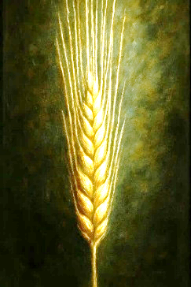
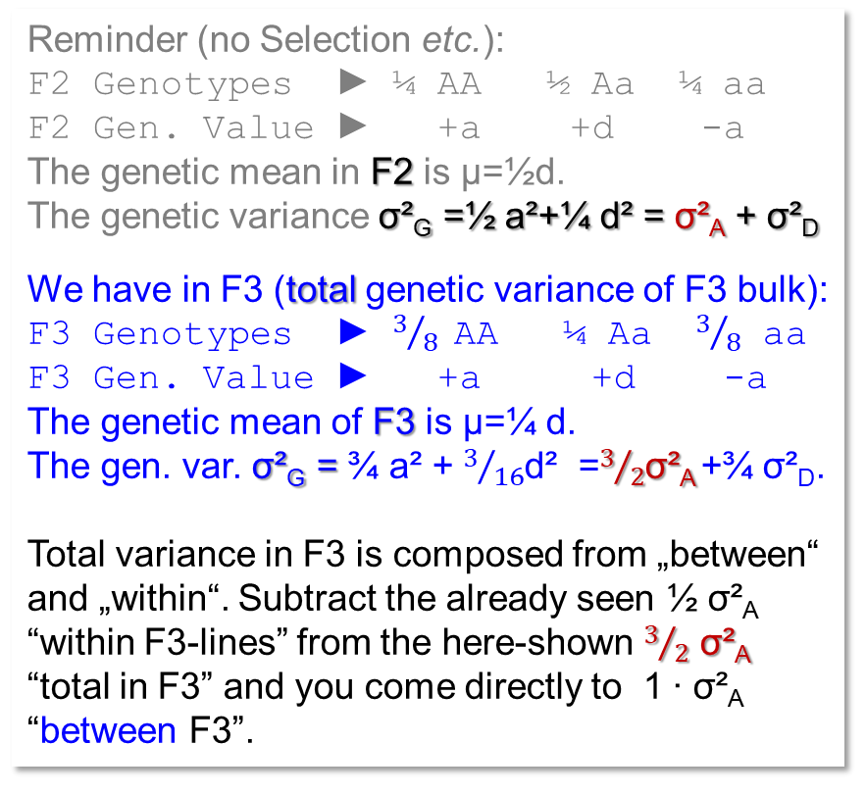
Same share of additive-genetic σ² between F2-individuals & between their F3-lines.
Reminder (no Selection etc.):
F2 Genotypes ► ¼ AA ½ Aa ¼ aa
F2 Gen. Value ► +a +d -a
The genetic mean in F2 is µ=½d.
The genetic variance σ²_{G} =½ a²+¼ d² = σ²_{A} + σ²_{D}
We have in F3 (total genetic variance of F3 bulk):
F3 Genotypes ► $3/8$ AA ¼ Aa $3/8$ aa
F3 Gen. Value ► +a +d -a
The genetic mean of F3 is µ=¼ d.
The gen. var. σ²_{G} = ¾ a² + $3/{16}$d² =$3/2$σ²_{A} +¾ σ²_{D}.
Total variance in F3 is composed from „between“ and „within“. Subtract the already seen ½ σ²_{A} “within F3-lines” from the here-shown $3/2$ σ²_{A} “total in F3” and you come directly to 1 ∙ σ²_{A} “between F3”.
Deduce the total variance in F3 yourself ☺!
25

Slide 26
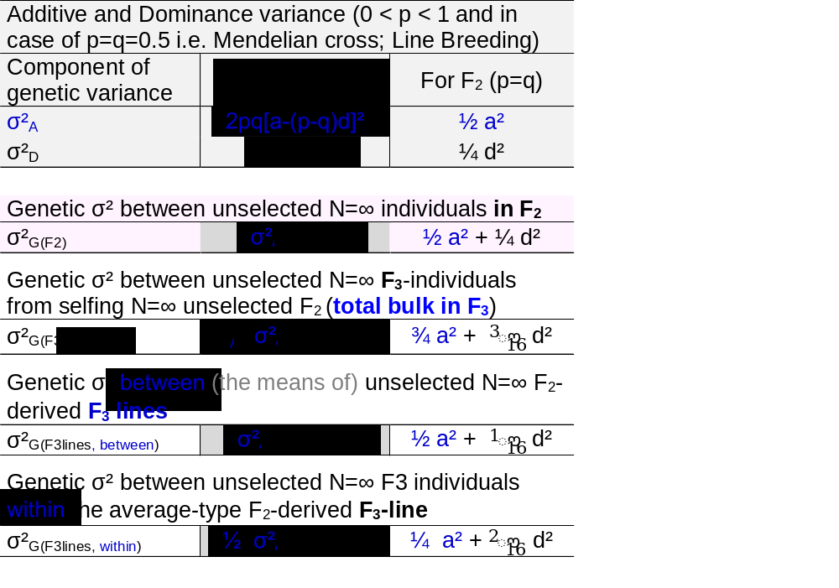
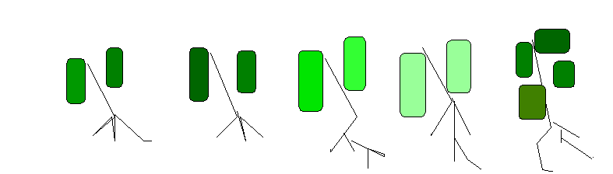
Same share of additive-genetic σ² between F2-individuals & between their F3-lines.
Reminder (no Selection etc.):
F2 Genotypes ► ¼ AA ½ Aa ¼ aa
F2 Gen. Value ► +a +d -a
The genetic mean in F2 is µ=½d.
The genetic variance σ²_{G} =½ a²+¼ d² = σ²_{A} + σ²_{D}
We have in F3 (total genetic variance of F3 bulk):
F3 Genotypes ► $3/8$ AA ¼ Aa $3/8$ aa
F3 Gen. Value ► +a +d -a
The genetic mean of F3 is µ=¼ d.
The gen. var. σ²_{G} = ¾ a² + $3/{16}$d² =$3/2$σ²_{A} +¾ σ²_{D}.
Total variance in F3 is composed from „between“ and „within“. Subtract the already seen ½ σ²_{A} “within F3-lines” from the here-shown $3/2$ σ²_{A} “total in F3” and you come directly to 1 ∙ σ²_{A} “between F3”.
Deduce the total variance in F3 yourself ☺!
26

Slide 27
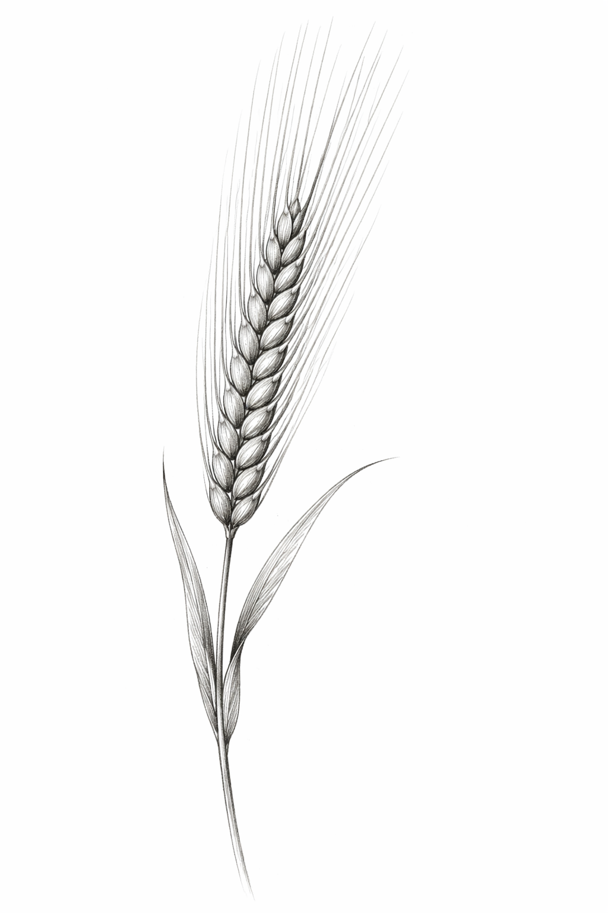
Shares of dominance genetic variance do change in a slightly more complicated way.
If there is no dominance, rather in a trait such as baking quality, then the amount of genetic variance between F2-individuals is the same as between the F2-derived F3-lines (each F3-line‘s value as mean of its N=∞ member individuals), and it is the same as between the F2-derived partial bulks in generation F4 and between the F2-derived partial bulks in F5; and so on.
Of course, for phenotypic assessment of, say, baking quality (value, variance), you may need more grains than what a single F2-plant offers; and data from several locations and seasons, and from plots of reasonable size to reduce bias from competition effects and to better mimic the plant canopy of farmers’ fields; and so on.
Barley
27

Slide 28
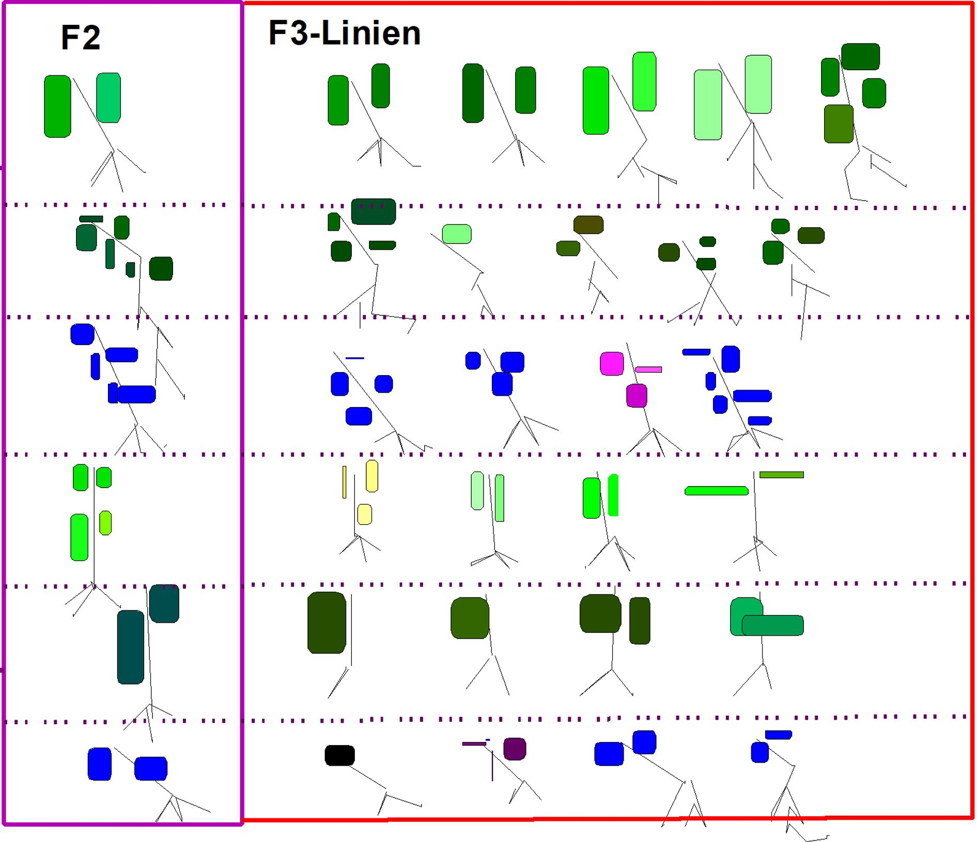
Just for fun, to visualize what is meant by Total variance in the Total Bulk in F3
F2 total bulk
F3 total bulk
The total variance in F2 segregated from the F1 ancestor first into its gametes (array of gametes) and then, when fertilizing its female gametes with its male gametes (i.e. selfing F1), then this segregation ‘became’ the diversity of the F2 generation: This total variance in F2 is σ²_{A} + σ²_{D}.
Harvesting the selfed seed of all (N=∞; no Sel-Mut-Migr-Drift) F2-individuals and assessing that offspring (F3, Total Bulk), this yields (usually) an increase in genetic diversity.
Additive variance increased by an additional 50% of what has been in generation F2.
Dominance? Dominance variance in F3 decreased to 75% of what has been in F2. F3 is expectedly half as heterozy-gous as F2, hence, compared to F2, in F3 only half as many individuals express the d effect. Yet, σ²_{D} is not halfed; this is because in parallel, the generation mean changed, from ½ d in F2 to ¼ d in F3 (per locus). This causes a decay of σ²_{D} which is not linear connected to the sequence of selfing generations (not linear to the Inbree-ding Coefficient F).
Total variance in F2
1.0 σ²_{A} + 1.0 σ²_{D}
Total variance in F3 bulk
1.5 σ²_{A} + 0.75 σ²_{D}
28

Slide 29
29
To visualize what is meant by ‚Variance between F3-lines ‘
F2 total bulk
F3 lines
Different from F2, where there is no meaningful grouping of individuals (I wrote so earlier, indeed) … here, in F3, we have two layers of variance.
One layer is the ‚echo‘ of the variance that was between the F2-individuals and is now inherited into ‚between-the-F3-lines‘. Indeed, with N=∞ individuals per F2-line (well, just say ‚many‘), all alleles that existed ‚in‘ any F2-indivi-dual will be existing in the F3-offspring derived from it, in same frequency (0% or 100% or 50%, of course). Hence, it is not too astonishing that (the mean of all members of) each F3-line kind-of corresponds to the value of its actual F2-ancestral individual.
… not too astonishing that basically genetic variance in F2 is translated into genetic variance between F3-lines (at least as far as additive gene action is concerned).
Variance between F3 lines
1.0 σ²_{A} + 0.25 σ²_{D}
Reminder: With p=q=0.5, σ²_{A} = ½ a²; σ²_{D} = ¼ a²

Slide 30
Visualize what is meant by ‚Variance within F3 lines‘. On average in this cross.
F2 total bulk
F3 within-lines
As said earlier:
The individuals that together ‚make‘ a single F3-line show less segregation, less genetic differences from each other than the F2-individuals that segregated from F1 in the first place.
From an additive-genetic point of view, and on average across all (very many) F3-lines, and for a polygenic trait, the average variance within an F3-line is expected as half of what has been additive variance in F2 (between the F2-individuals).
In the course of these selfing generations, F1 through F2 to F∞, breeders may see the dominance effects as mas-king effects. They only exist temporarily, they are transient. Once the lines are homozygous and homogeneous enough to be called ‘candidate cv’., heterozygosity (hence potential for d) is gone. Dominance is a nuisance if it masks recessive alleles so that they escape phenotypic selection in the early generations.
Total variance in F3 bulk
1.5 σ²_{A} + 0.75 σ²_{D}
Variance within F3 lines
0.5 σ²_{A} + 0.50 σ²_{D}
Variance between F3 lines
1.0 σ²_{A} + 0.25 σ²_{D}
30

Slide 31
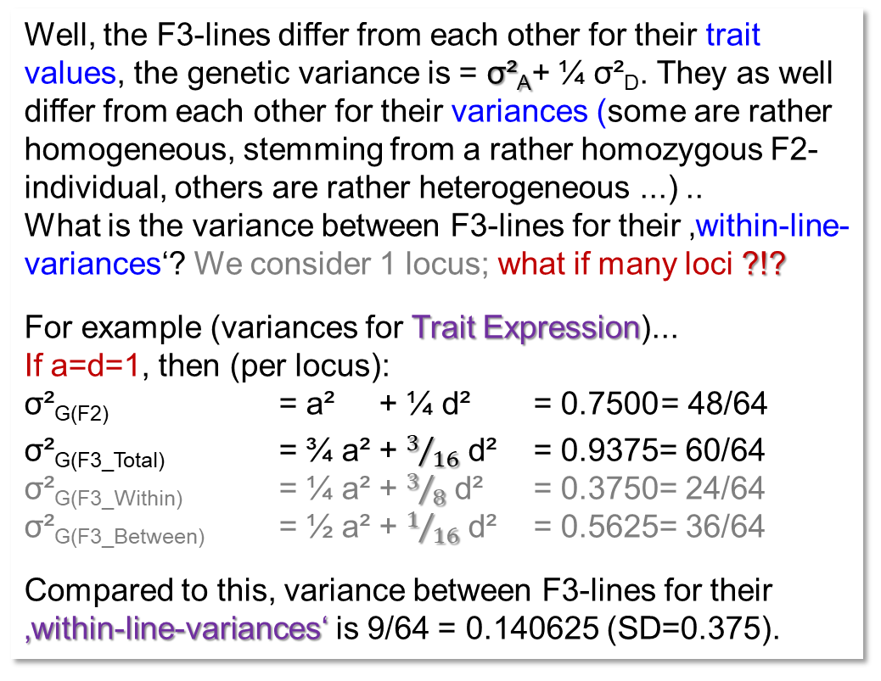
For nerds only: Segregation of F3-lines for their genetic within-line-variances !?
Well, the F3-lines differ from each other for their trait values, the genetic variance is = σ²_{A}+ ¼ σ²_{D}. They as well differ from each other for their variances (some are rather homogeneous, stemming from a rather homozygous F2-individual, others are rather heterogeneous ...) ..
What is the variance between F3-lines for their ‚within-line-variances‘? We consider 1 locus; what if many loci ?!?
For example (variances for Trait Expression)...
If a=d=1, then (per locus):
σ²_{G(F2)} = a² + ¼ d² = 0.7500 = 48/64
σ²_{G(F3_Total)} = ¾ a² + $3/{16}$ d² = 0.9375= 60/64
σ²_{G(F3_Within)} = ¼ a² + $3/8$ d² = 0.3750= 24/64
σ²_{G(F3_Between)} = ½ a² + $1/{16}$ d² = 0.5625= 36/64
Compared to this, variance between F3-lines for their ‚within-line-variances‘ is 9/64 = 0.140625 (SD=0.375).
A barley ear.
Barley as the canonical reference and reference case and paradigm for Line Breeding in a self-fertilizing crop.
The AI used here did not know about the barley-typical very large ligule and auricles - which is hence not seen here ;-)
DO 10.1111/jipb.12757.
If a=1 & d=0, then: σ²_{G(F2)} = 0.50 (σ² for Trait Expression)
σ²_{G(F3_Total)}=0.75; σ²_{G(F3_Within)}=0.25; σ²_{G(F3_Between)}=0.50
Compared to this, variance between F3-lines for their ‚within-line-variances‘ is 1/16 = 0.0625 (SD = 0.25).
Take home: F3-lines of a cross differ for their segre-gation potential; there is σ²_{G} between F3-lines for this.
31

Slide 32
‘F3-lines differ for segregation potential’; this has to be put into perspective!
This is true in reality. This is partly not true in Quantitative Genetic textbooks, because the foundation of Quantitative Genetics included the infinitesimal model.
https://theinfinitesimal.substack.com/p/what-is-the-infinitesimal
Under this assumption, with very many loci and very small effect per locus, and if you add LD=0, then more or less all differences between F2 individuals for their individual extent of heterozygosity vanish. With so many loci, each individual is a perfect sample of the basic pool of loci and does not deviate from the expectation (from the mean). The same is true in F3 and so on.
As said in UNPLAB-QuGen_Ch-10[GenV 0_F_1], Quantitative Genetics as default attitude neglects such differences, although practical Plant Breeding exploits them and often the best cultivars are born from such deviations. It is oftentime the outlier that does it.
F2
F3
32

Slide 33
Take home so far (still: Line Breeding, selfing from F1 onwards):
Multi-locus segregation causes new genotypic diversity in each selfing generation. The size of fresh segregation variance is proportionally to the meanwhile decreased degree of heterozygosity => the additional increment in variance can be neglected as early as (about) F₆ generation.
The additive share of the genetic variance in the basic generation F₂ is con-served (in case of no selection) across selfing generations. The already released part of the additive variance and the (in every generation newly) created additive variance accumulate. In later generations of selfing, the breeder therefore has markedly greater additive variance at her disposal than in the early generations of selfing.
That part of the genetic variance that is caused by dominance effects decreases from generation to generation. Already in about F₄ we can usually neglect dominance as cause of genetic variance.
33

Slide 34
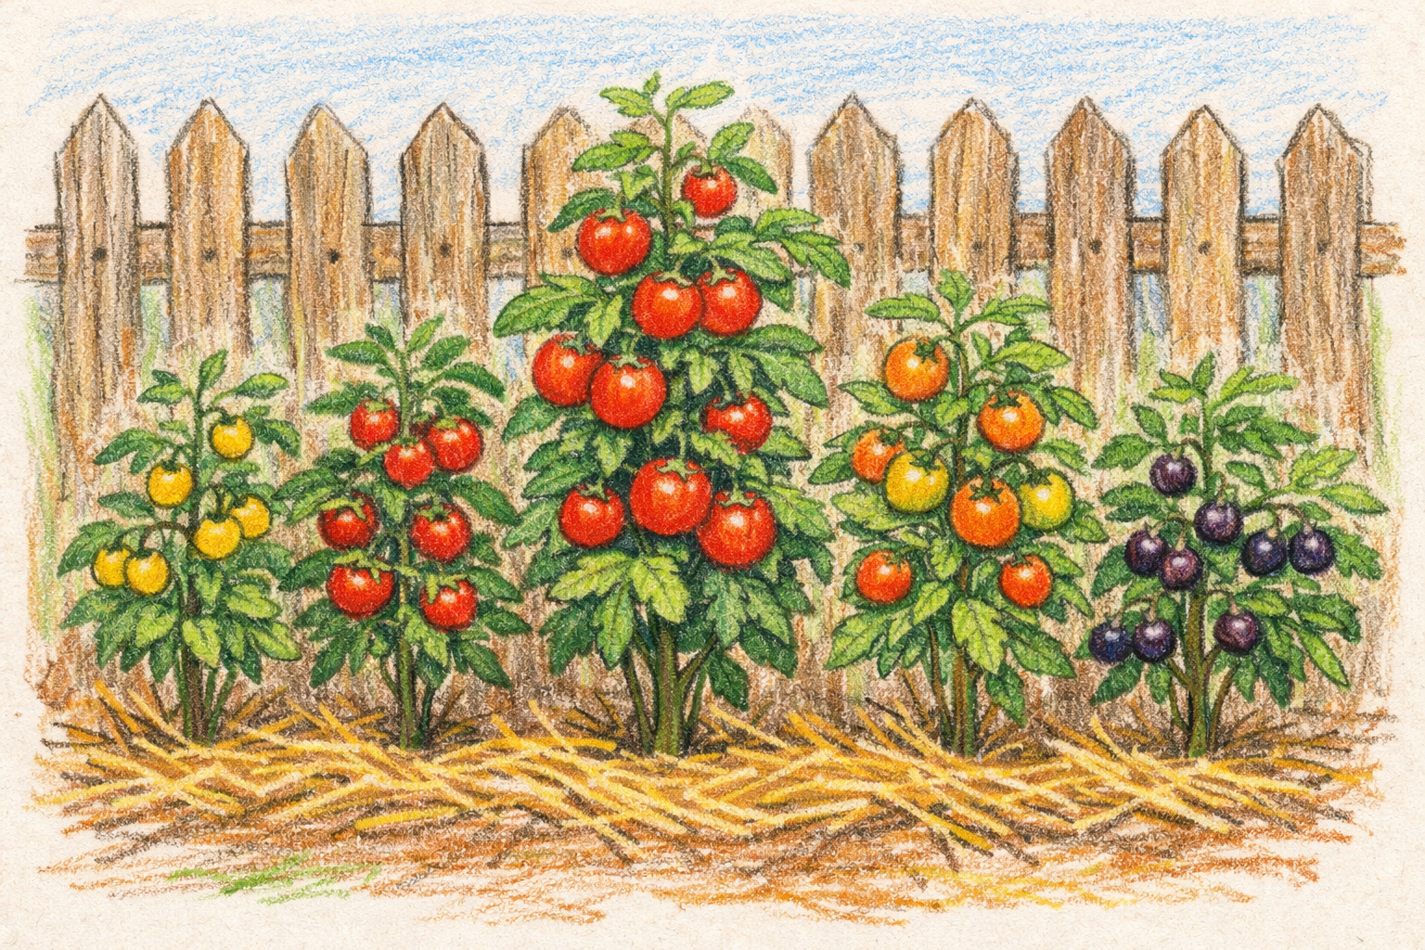
From here you may go to UNPLAB-QuGen_Ch-12[QG Lines II]
Tomato, a further self-fertilizing plant. No arable crop .. no com-bine harvest ;-) .. but a nice crop nevertheless, domestic-cated in Central America.
(Lycopersicon esculentum) is rather strictly self-fertilizing
(Horneburg and Becker, 2017.
Spontaneous outcrossing in tomato depends on cultivar and environment and varies bet-ween individual flowers. Plant Breeding. 2018;1-6.)
Yet, for instance, L. pimpinelli-folium, Johannisbeertomate, currant tomato) varies in its out-crossing rate depending on ge-netic variation of floral morpho-logy.
DOI 10.1093/genetics/161.1.333
34

